Slide 1

Week 02 Selecting a topic & Scientific Investigation
Masters of Information Systems & Technology
MIS 6220 RESEARCH METHODS
_{BY}
Prof. Jimmy K.N.Macharia,
Associate Professor of Information Systems &Technology, and
Dean, School of Science & Technology,
_{kmacharia@usiu.ac.ke}

Slide 2
Overview
Selecting a Topic
Hallmarks of Scientific Research Methods
Steps of the Scientific Method.

Slide 3
1.1 Selecting a Topic
Choosing the Title
There is no real formula for identifying a meaningful title.
The title describes the scope of the research.
Choose a title that captures the essence of your proposed project.

Slide 4
1.2. Selecting a Topic
The title should
Accurately describe the exact nature of the main element of the study.
Must be informative and relevant and should capture the attention of the reader.
Should not be too long (normally not more than 10 words) but should provide as much information about the study as possible.
Should preferably not be in a question form; it must define the research clearly, and must be clear and precise.
Should not contain technical terms, or jargon. The use of acronyms should be limited.

Slide 5
1.3. Selecting a Topic Exercise
Watch the video and come up with at least 4 characteristics of a good gaming program
………………………………………...
………………………………………...
…………………………………………
…………………………………………

Slide 6
1.3. Selecting a Topic Exercise
Watch the video and come up with at least 4 characteristics of a good gaming program
Urgent Ophism
Social Fabric
Blissful Productivity
Epic Meaning

Slide 7
1.3. Selecting a Topic Exercise
Watch the video and come up with at least three Research topics
………………………………………...
………………………………………...
…………………………………………

Slide 8
1.3. Selecting a Topic
The example topics from the video
To investigate the influence of addictive power of gaming to solve environmental problems.
To investigate the influence of addictive power of gaming to solve health problems.
To investigate the influence addictive power of gaming to solve social problems

Slide 9
1.2 What is Meant by a Scientific Research?
9
Scientific research focuses on solving problems and pursues a
step-by-step logical, organized, and rigorous method to identify the problems, gather data, analyze them, and draw valid conclusions therefrom.
problems,
Thus, scientific research
is not based on hunches, experience, and intuition (though these may play a part in final decision making), but a purposive and rigorous.

Slide 10
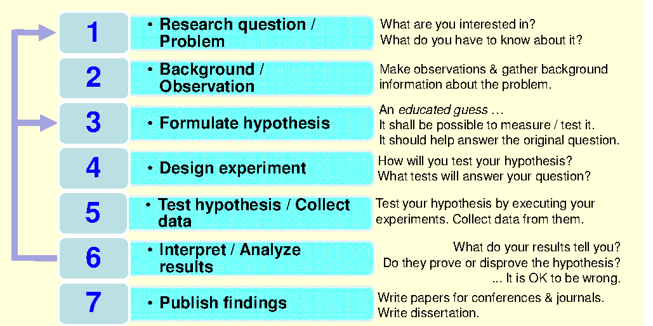
1.3 Overview of Research Methods : Classical Phases

Slide 11
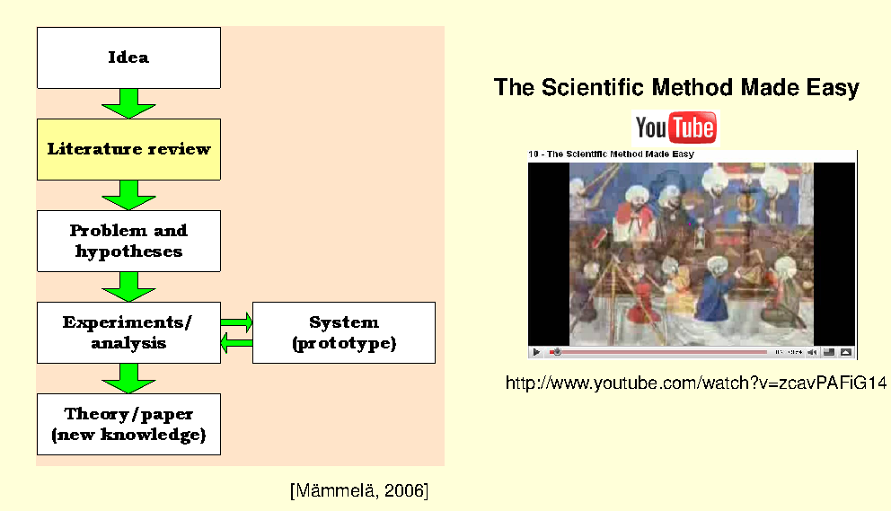
2.4 Overview of Research Methods : Other Variants

Slide 12
3.0 The Hallmarks of Scientific Research
12
The Hallmarks or main distinguishing characteristics of scientific research may be listed as follows:
1. Purposiveness 5. Precision
2. Rigor 6. Objectivity
3. Testability 7. Generalizability
4. Replicability 8. Parsimony

Slide 13
Deduction and Induction
Deductive reasoning: application of a general theory to a specific case.
Hypothesis testing
Inductive reasoning: a process where we observe specific phenomena and on this basis arrive at general conclusions.
Counting white swans
Both inductive and deductive processes are often used in research.
13
13

Slide 14
3.1 Steps of The Scientific Method
Step 1: Identify a broad problem area
Step 2: Formulate Research question / Problem
Step 3: Background / Observation/Lit. Review
Step 4: Formulate hypothesis
Step 5: Design experiment/Determine measures
Step 6: Collect data
Step 7: Test hypothesis /Analyse Data
Step 8: Interpret Analyse results
[Step 9: Publish findings] No longer optional

Slide 15
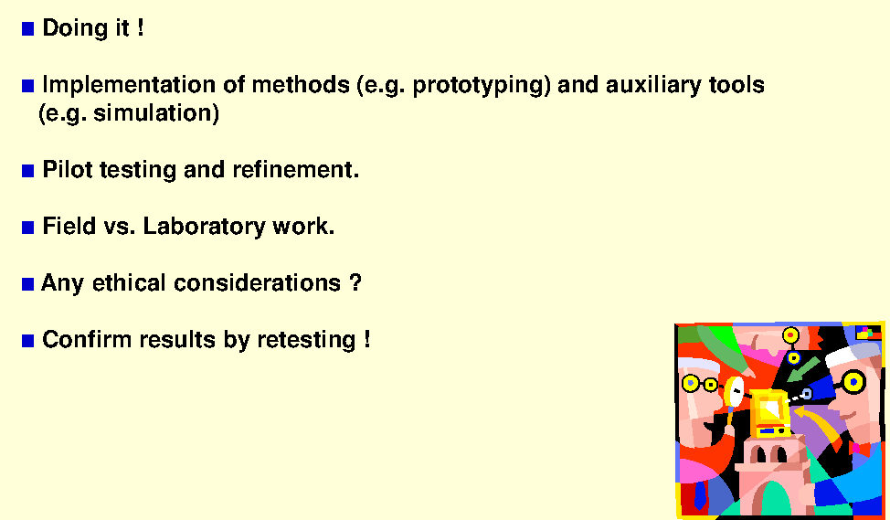
Ethics: eg Collect data/Simulate/Experiment

Slide 16
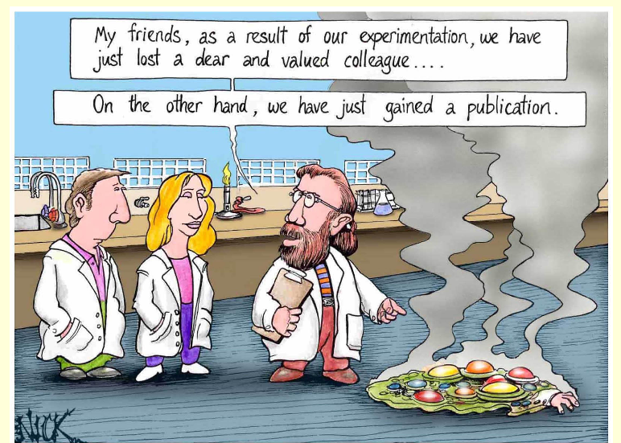
Ethics : Collect data/Simulate/Experiment

Slide 17


